Slide 1


ALDOT PROJECT #: CRPNU-0013(643)
ROUNDABOUT AND SIDEWALK IMPROVEMENTS AT THE INTERSECTION
OF AL-13 (US-43), AND AL-14
GREENE COUNTY
Notes:
Welcome and thank you for participating in the online public involvement for the proposed roundabout and sidewalk improvement project on US-43 and AL-14.

Slide 2
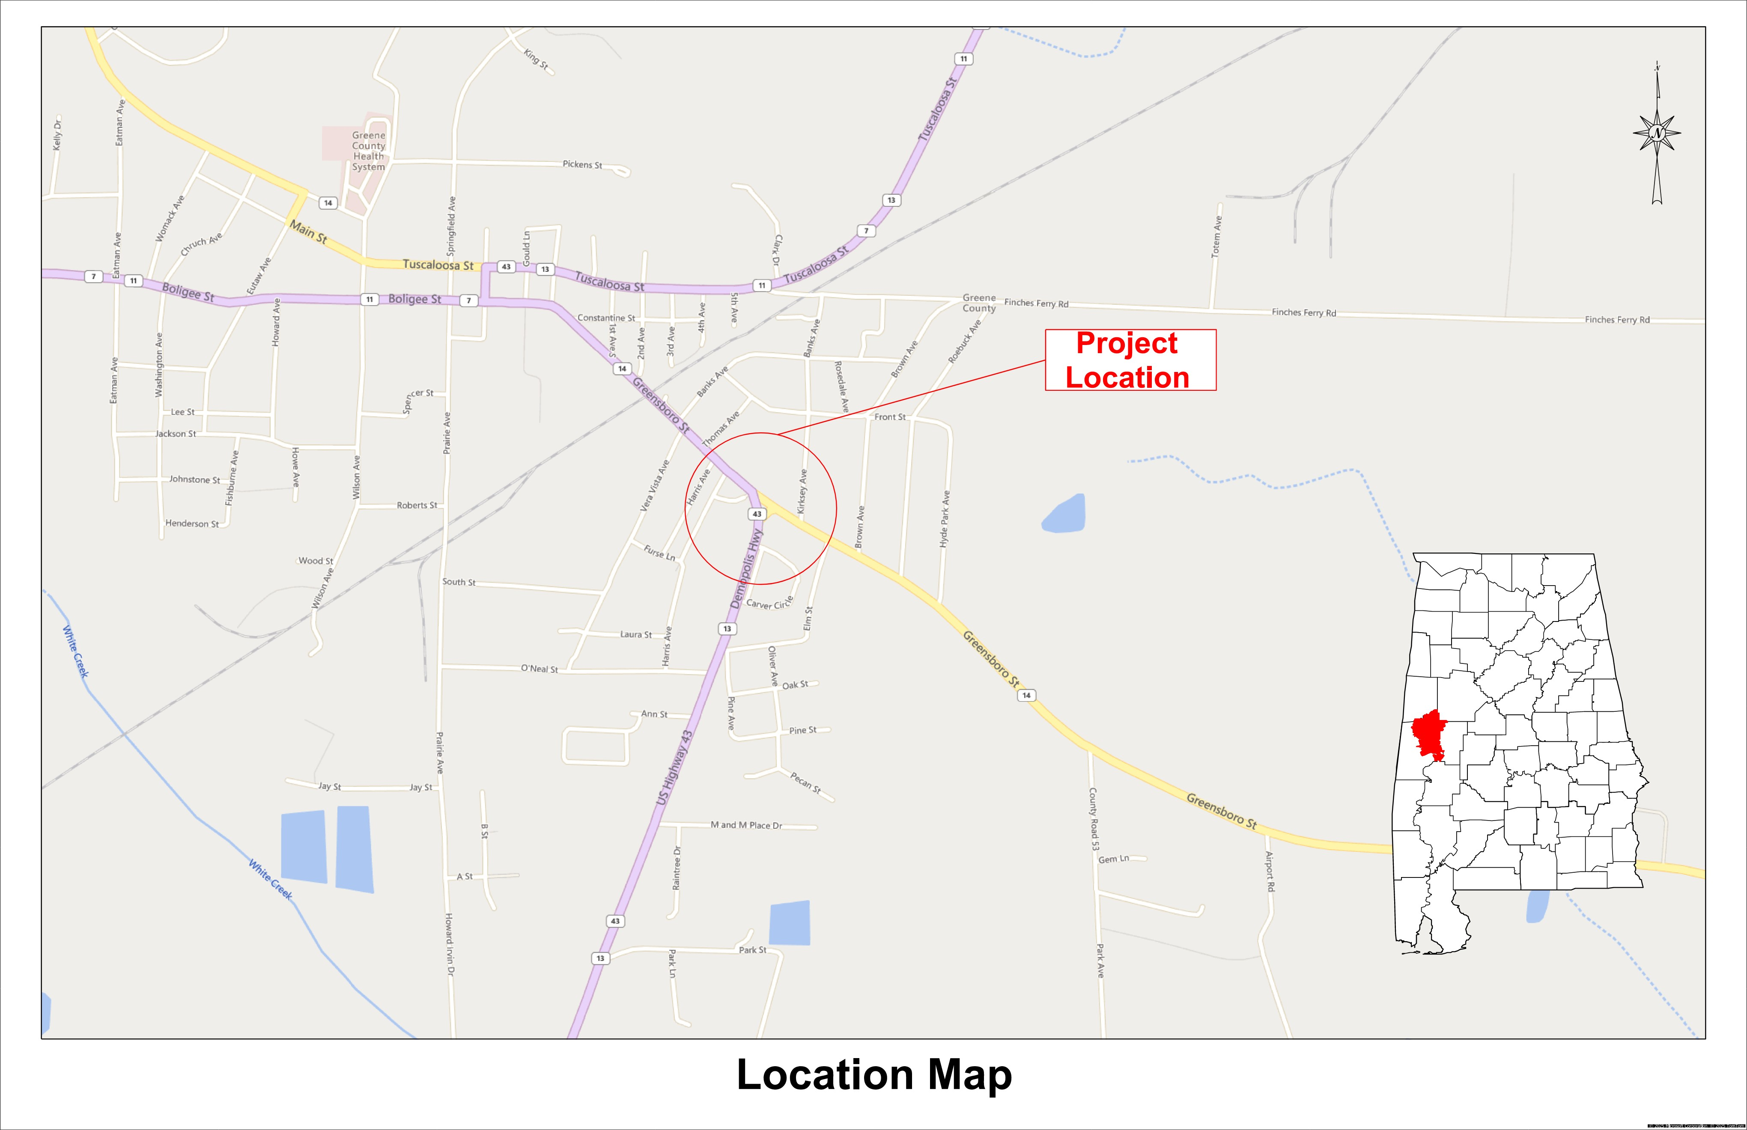
PROJECT LOCATION
The project is located at the intersection of AL-13 (US-43) and AL-14 in Eutaw.
Notes:
The project is located in Greene County in the City of Eutaw. The population of Eutaw is approximately 3,000. Currently, more than 5,900 vehicles use this intersection per day.

Slide 3

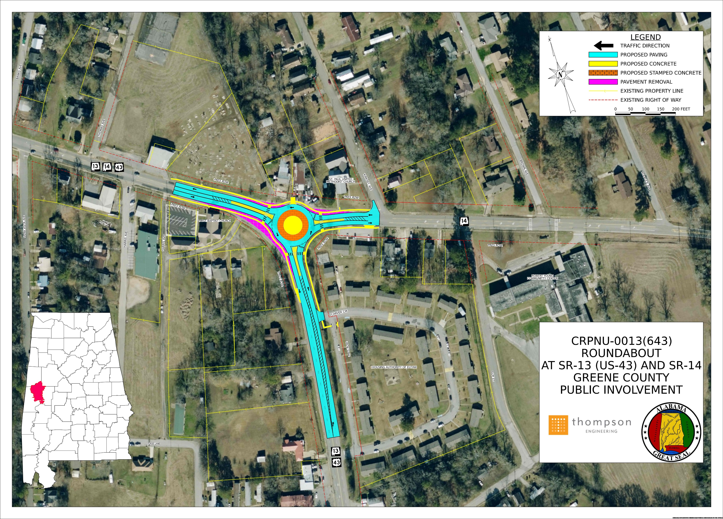
The purpose of this project is to improve traffic flow at the intersection of AL-13 (US-43) & AL-14 and to improve the pedestrian route within the project limits.
Notes:
The purpose of this project is to improve traffic flow at the intersection of SR-13 (US-43) & SR-14 and to improve the pedestrian route to within the project limits in Eutaw, Greene County, Alabama
This project will add a roundabout complete with pedestrian access and improved sidewalks. The roundabout will include pedestrian islands in the cross walks.

Slide 4

ALDOT Public Involvement In-Person Meeting
Tuesday, August 19th 2025
5 PM to 7 PM
Eutaw City Hall
116 Main Street
Eutaw, AL 35462
The meeting facilities are wheelchair accessible. Please call 205-507-4487 for requests for special assistance. Requests need to be made at least 2 days in advance of the in-person meeting.
Notes:
An in-person meeting will be held on Tuesday, August 19th at the Eutaw City Hall from 5 pm to 7 pm. The meeting facilities are wheelchair accessible. Please call 205-507-4487 for requests for special assistance. Requests need to be made at least 2 days in advance of the in-person meeting.

Slide 5

Provide your comments
PUBLIC INVOLVEMENT
SUBMIT COMMENTS TO:
Online Comment Form: www.ALDOTinvolved.com
Email: us43-roundabout@dot.state.al.us
Phone: (205) 462-2702 (3-minute limit)
Mail Comments to: ALDOT– West Central Region Office
Attn: Environmental Coordinator
1100 JULIA TUTWILER DRIVE
Tuscaloosa, AL 35404
September 19, 2025 is the deadline for receiving comments and/or questions about the project.
Notes:
You may provide comments in-person at the meeting or via the comment form located on this website, e-mail, voicemail, or US mail as indicated here. Voicemails are limited to 3 minutes. Comments must be received by September 19, 2025.
Thank you for taking the time to review the information about the proposed project. We look forward to hearing from you.

